Slide 1



OData Services Version 1.0

Slide 2
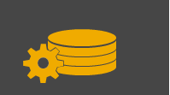
Agenda – OData Services
RESTful Services
OData
OData Services on HANA

Slide 3
OData and SAP HANA
The SAP HANA Development Curriculum is based on two fundamental building blocks of HANA native application development
Data access using OData services
User interface built on the SAPUI5 framework
This set of notes describes OData services which is a widely used data access standard based on RESTful services.

Slide 4
Agenda – OData Services
RESTful Services
OData
OData Services on HANA

Slide 5
Representational State Transfer (REST)
REST defines a set of architectural principles by which you can design Web services that focus on a system's resources, including how resource states are addressed and transferred over HTTP by a wide range of clients written in different languages.
REST has gained widespread acceptance across the Web as a simpler alternative to SOAP- and Web Services Description Language (WSDL)-based Web services.
Key evidence of this shift in interface design is the adoption of REST by mainstream Web 2.0 service providers — including Yahoo, Google, and Facebook — who have deprecated or passed on SOAP and WSDL-based interfaces in favor of an easier-to-use, resource-oriented model to expose their services.

Slide 6
Key Concepts
Client/Server
Client and server roles are independent so that neither depends on the specific implementation of the other
Request/Response
Interaction occurs through a series of independent requests and responses from client to server.
Loosely Coupled
The client doesn’t need to know the specific connection details to the end server. A number of intermediary layers may be present. The client uses a URI to connect but the details of how the connection is made are not relevant to the client.
Stateless
Each call from the client to the server is independent and no state information is stored on the server. State information is stored on the client. Each request to the server contains all the information required for that request.
HTTP
Interaction uses Uniform Resource Identifiers (URI) and HTTP verbs

Slide 7
REST Principles
Use HTTP methods explicitly according to HTTP standard.
Be stateless:
URI/getNextPage (stateful because it depends on previous page)
URI/getPage(2) (stateless)
Expose representations using directory structure-like URIs.
REST Web service URIs should be intuitive to the point where they are easy to guess.
http://www.myservice.org/discussion/2008/12/10/{topic}
Transfer XML, JSON or both.

Slide 8
URI, URL and URN
An URI identifies a resource either by location, name, or both.
URLs and URNs are special forms of URIs.
URL
Identifies how to interact with a resource (where is it?)
http://www.google.com
ftp://www.ucc.uwm.edu/mobile
URN
Identifies the resource but not the location (what is it?)
urn:”namespace”:”identifier”
urn:isbn:0-486-27557-4

Slide 9
HTTP Verbs
Interaction between computer systems using HTTP is accomplished with the following verbs:
GET – Retrieve resource
POST - Create
PUT - Update
PATCH – Update (Partial modifications)
DELETE - Delete
http://www.w3schools.com/tags/ref_httpmethods.asp

Slide 10
Response Codes
HTTP defines a collection of response codes that coordinate actions between systems so that clients will know the outcome of their request:
404 Not Found
200 OK
201 Created
etc.
http://www.w3schools.com/tags/ref_httpmessages.asp

Slide 11
HTTP
The client’s request indicates the type of request (eg. GET) in the request line, additional parameters in the header (eg. userid and password) and URI in the message body.
Request Line
Request Headers
Message Body
User agent
Client
Request
Server
Response
The server responds with the status code (eg. 200 OK), a header with additional information (eg. HTML version) and the requested resource in the message body (eg. HTML file).
Status Information
Response Header
Message Body
http://en.wikipedia.org/wiki/Hypertext_Transfer_Protocol

Slide 12
http://en.wikipedia.org/wiki/List_of_HTTP_header_fields
GET /index.html HTTP/1.1 Host: www.example.com
User agent
Client
Request
Server
Response
HTTP/1.1 200 OK
Date: Mon, 23 May 2005 22:38:34 GMT
Server: Apache/1.3.3.7 (Unix) (Red-Hat/Linux)
Last-Modified: Wed, 08 Jan 2003 23:11:55 GMT
ETag: "3f80f-1b6-3e1cb03b"
Content-Type: text/html; charset=UTF-8
Content-Length: 131
Connection: close
<html> <head> <title>An Example Page</title> </head> <body> Hello World, this is a very simple HTML document. </body> </html>

Slide 13
Resources and Representations
agent (example.com)
GET /Resource HTTP/1.1
Accept: application/XML
http://example.com/Resource
Resources
A resource is a document, data, etc. on a server that a client can request. The resource may have multiple representations (eg. JSON and XML) so the client indicates the acceptable representations in it’s request header.
HTTP/1.1 200 OK
XML Representation of Resource

Slide 14
Representations
A representation is a view of a resource at an instance in time
e.g. XHTML, Atom, XML, JSON, MP3, JPEG, plain text
Web components exchange the representations of resources, not the resources themselves
Resource
Representation
http://example.com/Customers.json
http://example.com/Customers.xml
Representation
http://example.com/Customers
Representation

Slide 15
Agenda – OData Services
RESTful Services
OData
OData Services on HANA

Slide 16

Open Data Protocol (oData)
“ODBC for the Web”
OASIS standard
The simplest definition of OData would be that it is a standardized protocol built on existing HTTP and REST protocols supporting CRUD (Create, Read, Update, Delete) operations for creating and consuming data APIs.
http://www.odata.org/

Slide 17
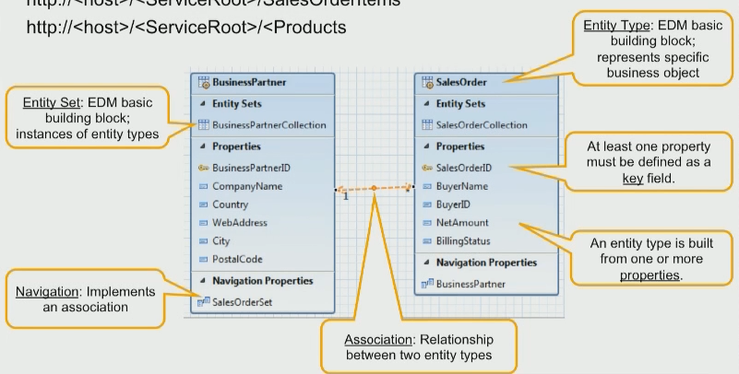
OData Data Model
The data model created on the server consists of:
Entity sets of Entity types
Properties
Associations between entity sets
Navigations
The service document is a resource that a client can request that identifies all the entity sets and associations among them.
The details of the entity sets can be retrieved in the metadata document.

Slide 18
Examples
The following slides provide some examples of OData requests.
The examples are based on the sample services provided at odata.org.
http://www.odata.org/odata-services/
The odata.org documentation is excellent especially the URI conventions documentation
http://www.odata.org/documentation/odata-version-3-0/url-conventions/ (for example)

Slide 19
Basics
Service document (service root URI)
http://services.odata.org/OData/OData.svc
Metadata document
http://services.odata.org/OData/OData.svc/$metadata
Entity set of Categories
http://services.odata.org/OData/OData.svc/Categories
Entity with key 0 of type Category
http://services.odata.org/OData/OData.svc/Categories(0)
All Products associated with Category with key 0 (Navigate one-to-many relationship)
http://services.odata.org/OData/OData.svc/Categories(0)/Products

Slide 20
Query Parameters Added to Basic URIs
$format
http://services.odata.org/OData/OData.svc/Categories?$format=json
$filter
http://services.odata.org/OData/OData.svc/Categories?$filter=Name eq 'Food'
$orderby
http://services.odata.org/OData/OData.svc/Categories?$orderby=Name
$select
http://services.odata.org/OData/OData.svc/Products?$select=ID,Price
$skip and $top
http://services.odata.org/OData/OData.svc/Products?$skip=0&$top=4

Slide 21
Agenda – OData Services
RESTful Services
OData
OData Services on HANA

Slide 22
SAP OData Services
SAP has made a big commitment to OData making it one of the principle methods for accessing data on SAP systems:
Data on Business Suite systems can be accessed using OData through SAP NetWeaver Gateway.
You can learn about OData services on NetWeaver Gateway by registering for a free developer account.
Information at http://scn.sap.com/docs/DOC-31221
OData services are native to SAP HANA systems and SAPUI5 is designed to consume OData services seamlessly.

Slide 23
OData on SAP HANA
OData services are defined in OData service definition files with an .xsodata extension in SAP HANA. Multiple services can be defined in a single document.
The language used to define service definitions is called OData Service Definition Language (OSDL).
The examples on the following slides provide only examples. For more information see http://help.sap.com/hana/SAP_HANA_Developer_Guide_en.pdf

Slide 24
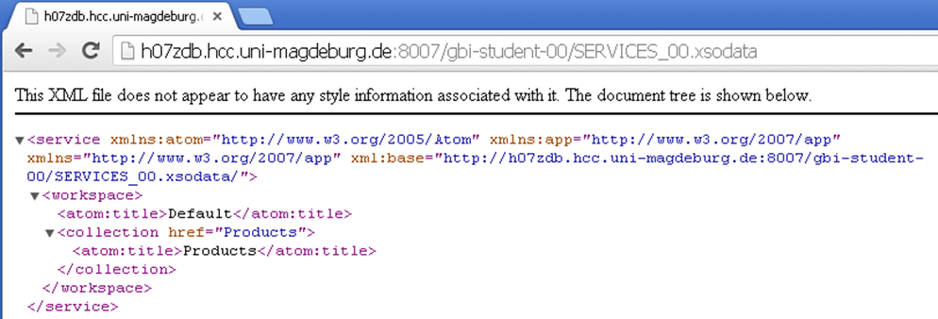
OData Services on HANA
Defining a service on SAP HANA requires only one line of code. This creates a services that exposes the GBI_DEMO1_PRODUCT table which is part of the GBI_DEMO1 database schema and names the entity set Products.
Table
Entity set name
service {
"GBI_DEMO1"."GBI_DEMO1_PRODUCT" as "Products";
}
Schema
The resulting service document

Slide 25
OData Service Based on Analytic View
The format for defining services based on views is similar to that based on tables except that, because views don’t have primary keys, the service definition must specify the key fields using the keyword key.
service {
"gbi-demo1-pack::GBI_DEMO1_SALES_AV" as "Sales"
key ("ORDER_NUMBER","ORDERN_ITEM")
aggregates always;
}
The phrase aggregates always indicates that the HANA system should use the definition of the view to determine how to aggregate the data returned in the service. Aggregations can also be explicitly defined in the service definition. The service below aggregates the Amount property. To aggregate Amount on year, for example, add $SELECT = year to the URI.
service {
"sample.odata::revenues" as "Revenues"
keys generate local "ID"
aggregates always (SUM of "Amount");
}

Slide 26
Defining Associations
"GBI_DEMO1"."GBI_DEMO1_CUSTOMER " as "Customers";
"GBI_DEMO1"."GBI_DEMO1_SALESORG" as "SOrg"
navigates ("SOrg_Customers" as "SOrgCustomers");
association "SOrg_Customers" principal "SOrg"("SALES_ORGANISATION")
multiplicity "1” dependent "Customers"("SALES_ORGANISATION") multiplicity "*";
This code defines a service called Customers based on the GBI_DEMO1_CUSTOMER table. It then defines a service called SOrg based on the GBI_DEMO1_SALESORG table. Finally, it defines a 1-to-many Association named SOrgCustomers between the SOrg service and the Customer service.

